Slide 1


Adrian de Wynter

Slide 2
Will GPT-4 (and 5!) Run
Adrian de Wynter

Slide 3

Will GPT-4 (and 5!) Run
Adrian de Wynter

Slide 4
Today we’ll go over an updated version of Will GPT-4 Run DOOM?
We (or rather, you) will learn:
Whether GPT-4 can run DOOM
Whether GPT-4/5 and Phi-4 can play DOOM
Why is this useful in (contemporary) research proper
Ethical implications and follow-ups for research
De Wynter, Adrian. Will GPT-4 Run DOOM? IEEE Transactions on Games (2024)

Slide 5
Why are we doing this?
We will make the case that LLMs playing videogames is an excellent benchmark of their cognitive capabilities:
Reasoning (spatial, visual)
Planning (long horizon, short-term)
Truthfulness (hallucinations, spurious steps)
Research has shown that:
LLMs do present proper in-context learning capabilities (they just forget at the next call)
LLM understanding is quite shallow. They seem like they know what they are talking about, but when measuring their understanding in a formal way, they fail.

Slide 6
But why DOOM?
Because it has been shown to run on various things:

Slide 7
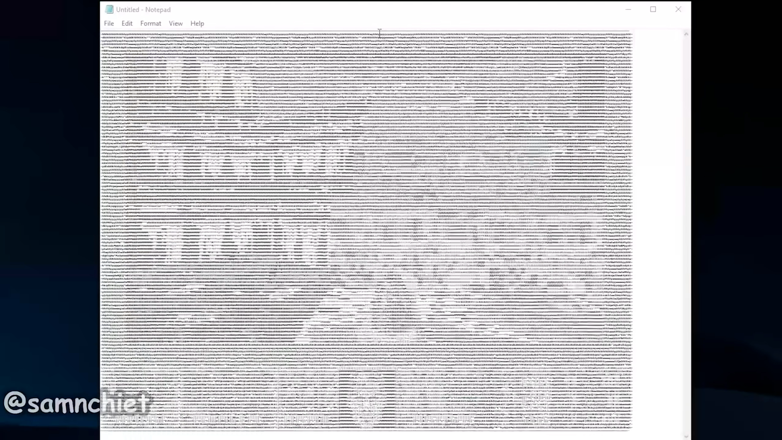
But why DOOM?
Notepad

Slide 8

But why DOOM?
A TI-84 powered by potatoes.

Slide 9
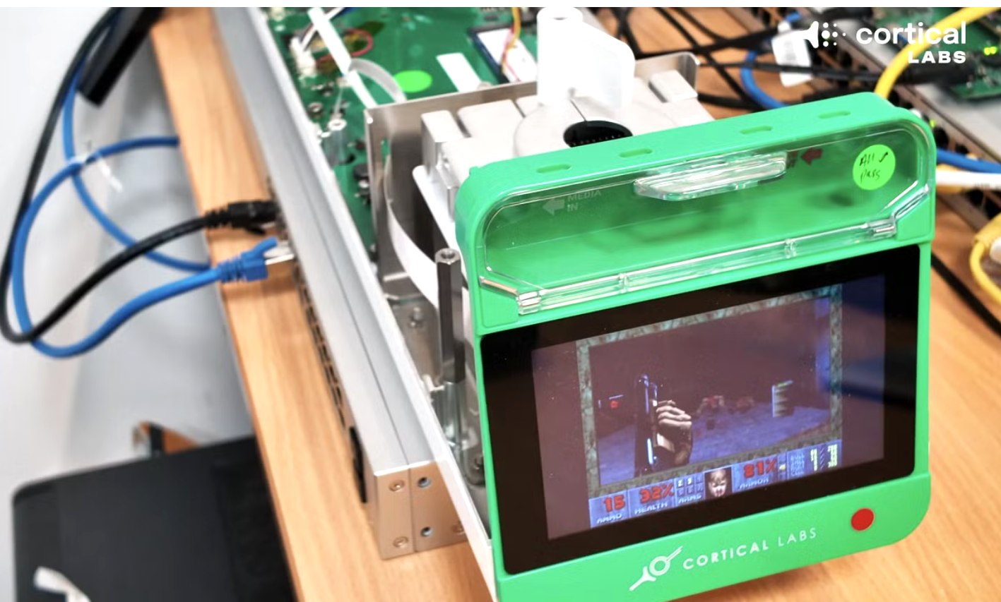
But why DOOM?
Human neurons

Slide 10
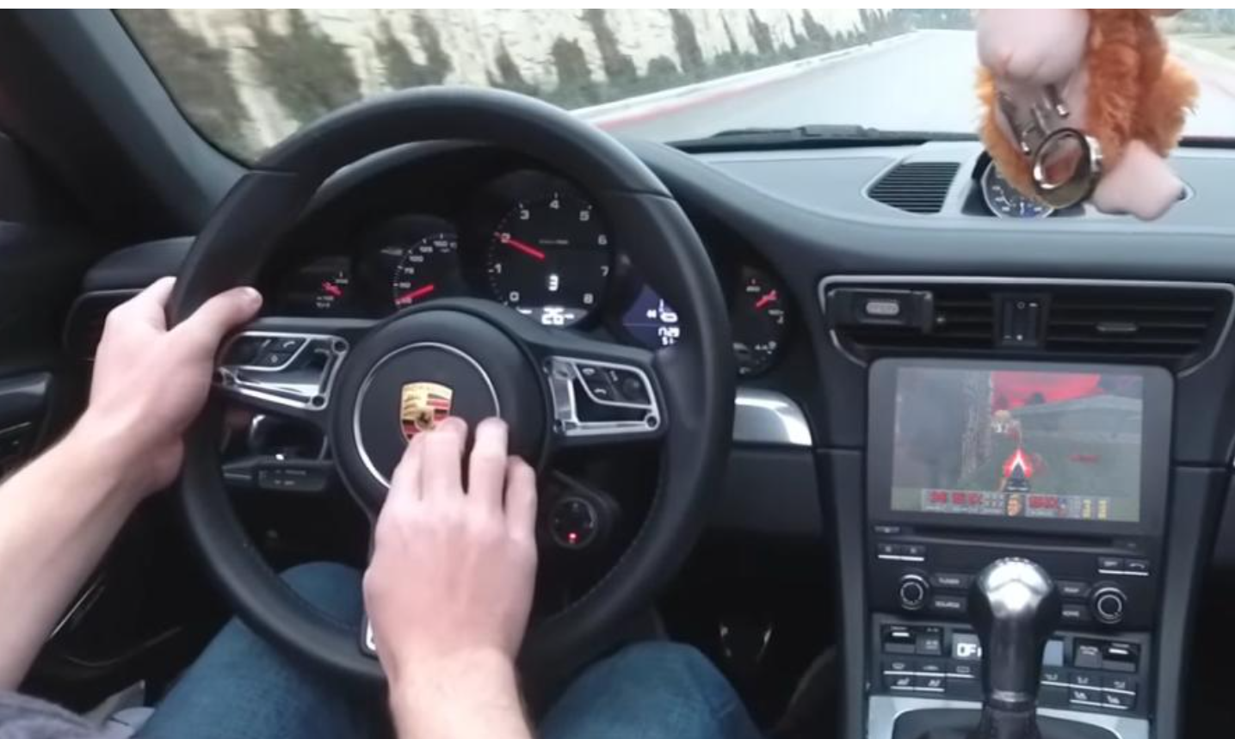
But why DOOM?
A Porsche 911

Slide 11
TL;DR
LLMs (here GPT-4, GPT-5, and/or Phi-4) cannot really run Doom by themselves.
Current LLMs are strictly limited by their input size.
They can play DOOM, though:
They act as proxies for the engine, and thus also play it to various degrees.
Sometimes the best approach is a (complex) agentic workflow.
But they do not reason nor plan well:
They (still) lack object permanence.
Their spatial orientation / planning is also quite lacklustre.
They run out of bullets a lot.

Slide 12
TL;DR (more)
Reasoning as interpreted via natural language in LLMs is not a reliable bar to evaluate their ‘thought’ process.
Explanations were typically hallucinated.
The main takeaways of the paper have nothing to do with LLMs being good or bad at the game, imo:
Videogames are excellent testing grounds for VLMs
They are great dynamic and reactive environments to test reasoning and generalisation.
There is something happening here (in the models).
The LLMs could react to their environment as instructed.

Slide 13
TL;DR (more)
Reasoning as interpreted via natural language in LLMs is not a reliable bar to evaluate their ‘thought’ process.
Explanations were typically hallucinated.
The main takeaways of the paper have nothing to do with LLMs being good or bad at the game.
Videogames are excellent testing grounds for VLMs
They are great dynamic and reactive environments to test reasoning and generalisation.
There is something happening here (in the models).
The LLMs could react to their environment as instructed.

Slide 14
TL;DR (more)
Reasoning as interpreted via natural language in LLMs is not a reliable bar to evaluate their ‘thought’ process.
Explanations were typically hallucinated.
The main takeaways of the paper have nothing to do with LLMs being good or bad at the game.
Videogames are excellent testing grounds for VLMs
They are great dynamic and reactive environments to test reasoning and generalisation.
There is something happening here (in the models).
The LLMs could react to their environment as instructed.

Slide 15
Will GPT-4 Run DOOM?

Slide 16
No.

Slide 17
No.
Thank you for your attention. Any questions?

Slide 18
Will GPT-4 Run DOOM?
Agentic workflows / tools do not count (e.g., creating a Doom port for ChatGPT). We are talking about running in the frozen weights, not calling the existing source code.
With that constraint, no current LLM can really run Doom by itself.
It needs sufficient memory to keep track of the states and render stuff:
  A 40x72 display (smallest I could find) is 2880 bits. It’s not bad, but well-beyond GPT-4’s capabilities.
  After all, it was trained for natural language, not... ASCII.
Then there’s the issue of hallucinations.
Running a videogame is in PSPACE:
  You have the source which encodes the full world and states.
  It’s quite large for an LLM.

Slide 19
Will GPT-4 Play DOOM?
Yes!

Slide 20
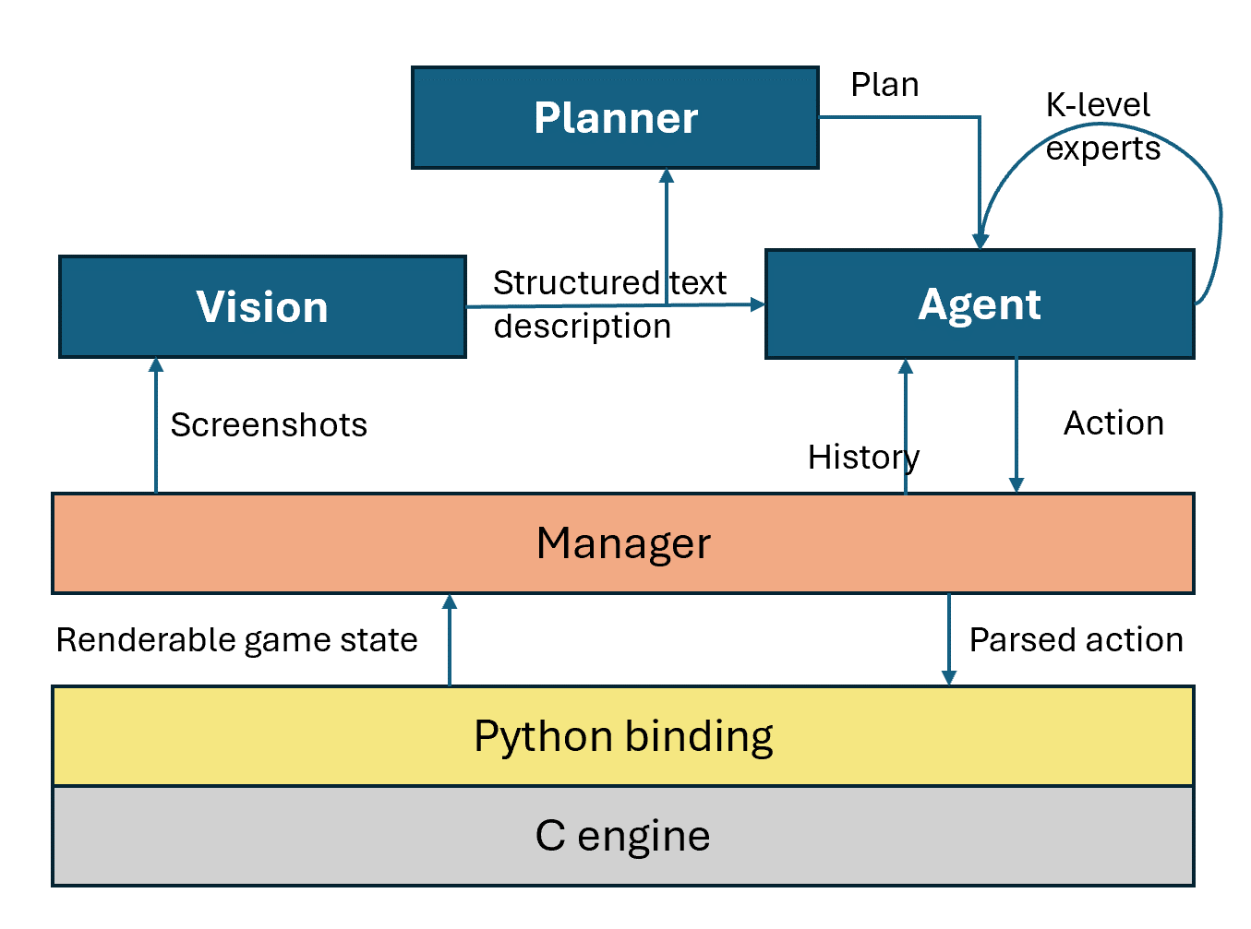
Will GPT-4 Play DOOM?
It does it to a passable degree.
We just need a proxy for the engine (right) and a few strategies.
Strategy I (‘agentic workflow’):
A vision-agent workflow plus:
A planner, and optionally
K-Level experts (like time travel)
Strategy II (‘I can’t believe that worked’):
Same LLM reads and plays the game in one call (GPT-5 and Phi-4 only).
The VLM interfaces with Doom via a Python binding, which sends it screenshots and gets NL descriptions.

Slide 21
Results
Most LLMs do well with a walkthrough.
For GPT-4, more complex workflows yielded better results.
GPT-5 is a much more efficient door-opener and zombie-shooter than GPT-4.
Its main problem was planning long-term, and object positionality.
It was better in simple call schemes, not full agentic workflows
Still, the GPT models were pretty good at ad hoc decisions.

Slide 22

GPT-4: Planner only
Observe:
Disorientation
Shooting unnecessarily shootable things.
Wall hugging

Slide 23

GPT-4: k-level experts
Ok-ish map traversal skills
Stuck in corners and randomly shooting things
Peekaboo and swimming in acid problems
Reaction skills are good

Slide 24
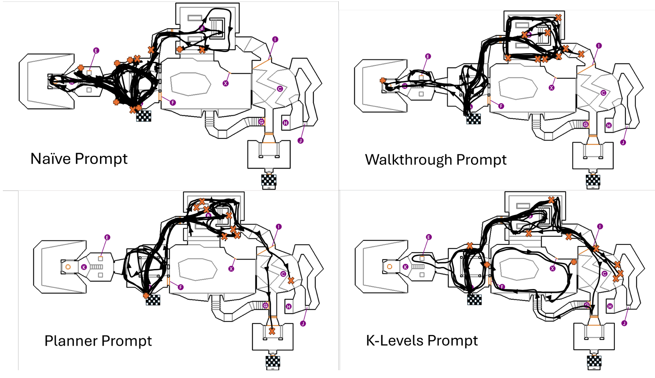
Agentic Workflows are Better
The naïve prompt could not leave the first room
The walkthrough prompt got stuck often.
The planning prompt and almost finished the map.
K-levels consistently reached room C, though died by stepping on acid.

Slide 25

GPT-5 (Vision-Agent)
Better than a naïve prompt and k-levels/planners.
It made it to the end… but it ran out of bullets ☹️
Observe its navigational/planning skills (backtracking!)

Slide 26

Phi-4
…

Slide 27
The Good Stuff: Reasoning and Learning
LLMs are very good at giving the impression that they are intelligent.
Still, there are truly interesting things LLMs can do by interpreting strings and returning strings.
For this, we need negative results (bear with me):
LLMs (still, as of GPT-5) lack object permanence.
  For example, LLMs see a zombie on the screen, and fire at it.
  GPT-4 forgets about the zombie and just keeps going (and gets shot)
  GPT-5 had the same problem.

Slide 28
The Good Stuff: Reasoning and Learning
The same goes for spatial orientation and some degree of causal reasoning.
This was common on long/deep reasoning contexts.
So its reasoning is only effective in short/shallow contexts (a few frames).
LLM reasoning explanations are flawed.
Their rationales were often spurious
The vision outputs were good.
It is in-context judgement through language, not visual identification, which is the problem here.

Slide 29
However!
Closed-source models weren’t great, but finetuning could help.
From a cognitive perspective, that’s not as interesting as what they could do without being asked!
It’s absolutely remarkable that GPT-4 was not trained to play Doom, and still managed to get all the way to the last room (once).
This suggests some learning and understanding capabilities, although they aren’t robust
De Wynter, Adrian. Is In-Context Learning Learning? ICLR (2026)
De Wynter, Adrian, and Yuan, Tangming. The Thin Line Between Persuasion and Understanding in LLMs. Findings of the ACL 2026
Zhou, Yufa, et al. The Geometry of Reasoning: Flowing Logics in Representation Space. ICLR (2026)

Slide 30
However!
I’d encourage us to not get all schadenfreudy OR excited on their capabilities, and evaluate them instead as something new.
‘Something new’ doesn’t mean they’ll take over the world or be sentient, though.
For example, It is quite obvious that LLMs aren’t meeting existing claims in terms of capabilities and safety.
Their misuse has real, physical consequences and we should account for them.

Slide 31
Open Questions
Can LLMs really reason better with short contexts (a few frames)? Why?
Experiments with longer contexts showed that performance dropped as I extended their context window.
It might be a (still) lost-in-the-middle problem, but why? Recency bias should work here.
Would encoding temporal information explicitly improve reasoning capabilities in dynamic environments?
Try this with a video model or a foundation world model.
Is the reason why some agentic workflows behave better in some models than others tied to the LLM’s finetuning?
Why is it that older LLMs do better in logically more effective workflows?
Does it have to do with cheating benchmarks?
Suppose you fine-tune an FPS LLM. To which extent these skills transfer?
Follow up: which methods improve transferrability?

Slide 32
Open Questions
Can LLMs really reason better with short contexts (a few frames)? Why?
Experiments with longer contexts showed that performance dropped as I extended their context window.
It might be a (still) lost-in-the-middle problem, but why? Recency bias should work here.
Would encoding temporal information explicitly improve reasoning capabilities in dynamic environments?
Try this with a video model or a foundation world model.
Is the reason why some agentic workflows behave better in some models than others tied to the LLM’s finetuning?
Why is it that older LLMs do better in logically more effective workflows?
Does it have to do with cheating benchmarks?
Suppose you fine-tune an FPS LLM. To which extent these skills transfer?
Follow up: which methods improve transferrability?

Slide 33
Open Questions
Can LLMs really reason better with short contexts (a few frames)? Why?
Experiments with longer contexts showed that performance dropped as I extended their context window.
It might be a (still) lost-in-the-middle problem, but why? Recency bias should work here.
Would encoding temporal information explicitly improve reasoning capabilities in dynamic environments?
Try this with a video model or a foundation world model.
Is the reason why some agentic workflows behave better in some models than others tied to the LLM’s finetuning?
Why is it that older LLMs do better in logically more effective workflows?
Does it have to do with cheating benchmarks?
Suppose you fine-tune an FPS LLM. To which extent these skills transfer?
Follow up: which methods improve transferrability?

Slide 34
Open Questions
Can LLMs really reason better with short contexts (a few frames)? Why?
Experiments with longer contexts showed that performance dropped as I extended their context window.
It might be a (still) lost-in-the-middle problem, but why? Recency bias should work here.
Would encoding temporal information explicitly improve reasoning capabilities in dynamic environments?
Try this with a video model or a foundation world model.
Is the reason why some agentic workflows behave better in some models than others tied to the LLM’s finetuning?
Why is it that older LLMs do better in logically more effective workflows?
Does it have to do with cheating benchmarks?
Suppose you fine-tune an FPS LLM. To which extent these skills transfer?
Follow up: which methods improve transferrability?

Slide 35
Getting Serious
Any self-respecting AI scientist should have safety and ethics in mind. If they don’t, who will?
It is worrisome how easy it was for me to:
  write code to get the model to shoot something; and
  for the model to shoot something without second-guessing the instructions.
The real danger of AI is not it becoming sentient and turning into Skynet. It is AI blindly doing exactly what it was asked to do.

Slide 36


Slide 37
The full video is 🔥

Slide 38
A tool reflects the values of its creators.
Which are your values?

